Slide 1

Architecture and Working of Transformers in Deep Learning
Module 2

Slide 2
Definition
Transformers are a type of deep learning model that utilizes self-attention mechanisms to process and generate sequences of data efficiently.
They capture long-range dependencies and contextual relationships making them highly effective for tasks like language modeling, machine translation and text generation.
Transformer model is built on encoder-decoder architecture where both the encoder and decoder are composed of a series of layers that utilize self-attention mechanisms and feed-forward neural networks.
This architecture enables the model to process input data in parallel making it highly efficient and effective for tasks involving sequential data.

Slide 3
Definition
The encoder processes input sequences and creates meaningful representations.
The decoder generates outputs based on encoder representations and previously predicted tokens.

Slide 4
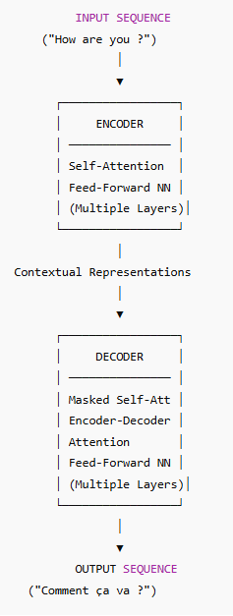
Example Sentence
Encoder → Reads entire input sentence in parallel using self-attention and produces contextual embeddings.
Decoder → Uses:
Previously generated words
Encoder’s output representations to generate the next word step-by-step.
This parallel processing and attention mechanism allow transformers to capture long-range dependencies efficiently.
“The transformer model translated the English sentence ‘How are you?’ into French by first encoding its meaning and then decoding it into ‘Comment ça va ?’.”

Slide 5
What are Long-Range Dependencies?
Long-range dependencies refer to relationships between words (or tokens) that are far apart from each other in a sentence or sequence, but still depend on each other for meaning.
Simple Example
Consider this sentence:
“If you study hard throughout the semester, even when it feels difficult and exhausting, you will succeed.”
The word “If” at the beginning connects logically to “will succeed” near the end.The model must understand that connection across many words.

Slide 6
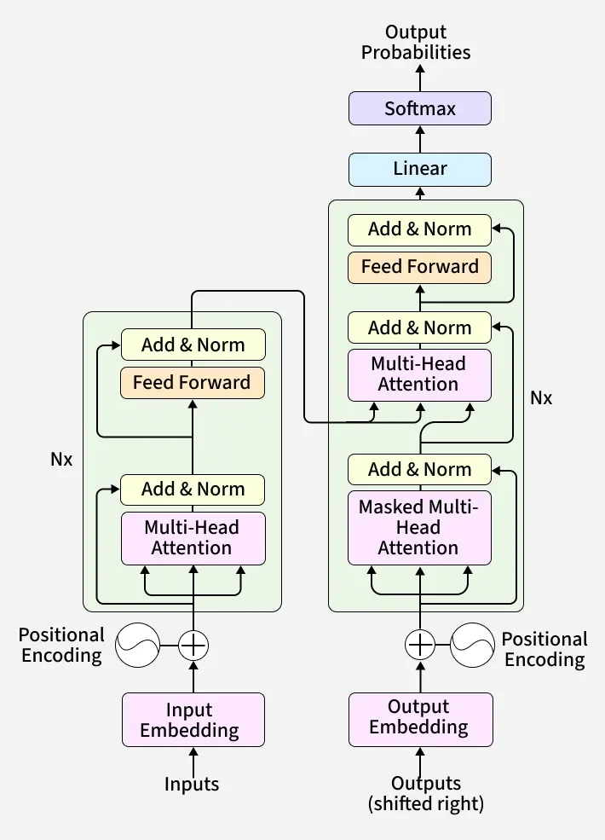
Overall Transformer Architecture, detailing Encoder and Decoder stacks with their respective sub-layers and data flow
I Like AI

Slide 7
Explanation
Step 1: Input Embedding
Words are converted into vectors.
Example: “I like AI” → numerical representations.
Step 2: Positional Encoding
Since transformers process words in parallel, they don’t automatically know word order.
Positional encoding adds position information to each word embedding.
So now each word vector contains:Word meaning + Position in sentence

Slide 8
Explanation
Step 3: Repeated Encoder Layers (Nx)
Each encoder layer contains:
(A) Multi-Head Self-Attention
Each word looks at all other words in the sentence.
It learns which words are important to each other.
“Multi-head” means it looks at relationships in multiple different ways.
(B) Add & Norm
A residual connection (adds input back to output).
Followed by Layer Normalization.
Helps stabilize training.

Slide 9
Explanation
(C) Feed Forward Network
A small fully connected neural network.
Applied to each position separately.
(D) Add & Norm again
This whole block is repeated N times.
➡ Final output = contextual representation of the entire input sentence.

Slide 10
Explanation (Decoder)
2. Decoder (Right Side)
The decoder generates output one word at a time.
Step 1: Output Embedding (Shifted Right)
The decoder takes:
Previously generated words
Shifted right (so it predicts the next word)
Example during training:
Input: <start> Comment ça va ?
Target: Comment ça va ? <end>

Slide 11
Explanation (Decoder)
Step 2: Positional Encoding
Same as encoder — adds order information.
Step 3: Decoder Layers (Nx)
Each decoder layer has three main parts:
(A) Masked Multi-Head Self-Attention
Similar to encoder self-attention.
But masked so it cannot see future words.
This prevents cheating during training.

Slide 12
Explanation (Decoder)
(B) Encoder–Decoder Attention
This is very important.
The decoder looks at:
Its own previous words
The encoder’s output
This allows the decoder to focus on relevant input words when generating output.
Example: When generating “va”, it may focus strongly on “are”.

Slide 13
Explanation (Decoder)
(C) Feed Forward Network
Same as encoder.
Each sublayer is followed by Add & Norm.

Slide 14
Final Output Layer
After decoder layers:
Linear Layer
Converts decoder output into vocabulary size.
Softmax
Converts scores into probabilities.
"Comment" → 0.70
"Bonjour" → 0.10
"Salut" → 0.05
Highest probability word is selected.

Slide 15
Example
We’ll use a tiny translation example:
Input sentence:
“Hello”
Target output:
“Bonjour”

Slide 16
Example
ENCODER SIDE
1️⃣ Input Embedding
The word: Hello is converted into a numerical vector:[0.21, -0.44, 0.90, ...]
This vector represents the meaning of the word in high-dimensional space.

Slide 17
Example
2️⃣ Positional Encoding
Since transformers don’t know word order automatically, we add position information.
Because "Hello" is the first word:
Now the model knows:
What the word means
Where it appears

Slide 18
Example
3️⃣ Multi-Head Self-Attention (Encoder)
Because we only have one word:
It attends to itself
Attention weight = 1
In longer sentences, it would compare itself to all other words.
Output:
Context-aware representation of "Hello"

Slide 19
Example
4️⃣ Add & Norm
Original input is added back (residual connection)
Then normalized
Purpose:
Stabilizes training
Prevents information loss

Slide 20
Example
5️⃣ Feed Forward Network
A small neural network processes the vector:
Linear → ReLU → Linear
This transforms the representation into a richer one.

Slide 21
Example
6️⃣ Add & Norm (Again)
Another residual + normalization step.
Now we have the final encoder output representation of "Hello".
This is passed to the decoder.

Slide 22
Example
🟢 DECODER SIDE
The decoder generates output word by word.
7️⃣ Output Embedding (Shifted Right)
During training, the decoder receives:
<START>
At inference time, it also starts with a start token.
This token is embedded into a vector.

Slide 23
Example
🟢 DECODER SIDE
8️⃣ Positional Encoding (Decoder)
Adds position information to the start token.
9️⃣ Masked Multi-Head Self-Attention
Since we only have <START>:
It attends only to itself.
Mask prevents looking at future words.

Slide 24
Example
🔟 Add & Norm
Residual connection + normalization.
1️⃣ Encoder–Decoder Attention
Now the important part:
The decoder looks at:
Its current token (<START>)
The encoder output ("Hello")
It asks:
"Which input word is relevant for predicting the next word?"
It attends strongly to the encoded "Hello".

Slide 25
Example
1️⃣2️⃣ Add & Norm
Again: residual + normalization.
1️⃣3️⃣ Feed Forward Network
Processes the vector further.
1️⃣4️⃣ Add & Norm
Final decoder representation for this time step.

Slide 26
Example
🔴 Final Output Layer
1️⃣5️⃣ Linear Layer
Converts decoder output into vocabulary scores:
Example:
Bonjour → 3.2
Salut → 1.1
Merci → 0.2

Slide 27
Example
1️⃣6️⃣ Softmax
Converts scores into probabilities:
Bonjour → 0.78
Salut → 0.15
Merci → 0.07
Highest probability:
"Bonjour"

Slide 28
Example
🔁 What Happens Next?
The decoder now feeds:
<START> Bonjour
back into itself to predict the next word.

